Slide 1



a data
container
$$⋯$$
A = cell(m, n) →
$$⋮$$
$$⋱$$

Slide 2


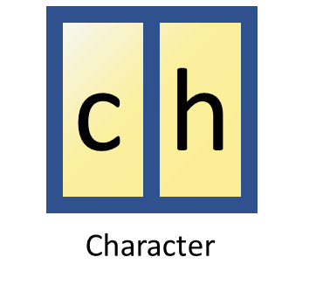
each data container can contain different data types
A = cell(1, 3) →

Slide 3
A = cell(1, 3) →
A(2)
A{1}

Slide 4
{
}
Cell
Structures

Slide 5

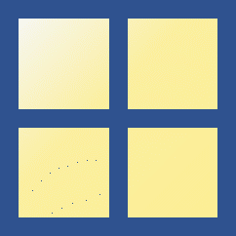
Encyclopedia
Science
Culture
Art
Craft

Slide 6
Table

Slide 7
Name | Retake? | Mid-term exam | Final exam
Gilbert | True | 86 | 100
Jim | False | 92 | 75
Amy | False | 84 | 55
Honglei | False | 55 | 88
Satoshi | True | 88 | 98

Slide 8
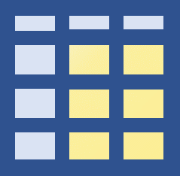
 | Retake? | Mid-term exam | Final exam
Gilbert | True | 86 | 100
Jim | False | 92 | 75
Amy | False | 84 | 55
Honglei | False | 55 | 88
Satoshi | True | 88 | 98
T:
T(1, :)
 | Retake? | Mid-term exam | Final exam
Gilbert | True | 86 | 100
T{1, :}
[1, 86, 100]

Slide 9
Name | Mid-term exam
John | 86
Kelly | 55
Angelo | 77
Name | Final-term exam
Angelo | 98
John | 76
Kelly | 86
Paul | 74
Gray | 81
Name | Mid-term Exam | Final-term exam
John | 86 | 76
Kelly | 55 | 86
Angelo | 77 | 98
+
⇒
T_Left
T_Right
join(T_Left, T_Right)

Slide 10
Name | Mid-term exam
Michio | 90
John | 86
Kelly | 55
Angelo | 77
Name | Final-term exam
Angelo | 98
John | 76
Kelly | 86
Paul | 74
Gray | 81
Name | Mid-term Exam | Final-term exam
Angelo | 77 | 98
John | 86 | 76
Kelly | 55 | 86
+
⇒
T_Left
T_Right
innerjoin(T_Left, T_Right)

Slide 11
Name_ T_Left | Mid-term Exam | Name_ T_Right | Final-term exam
Angelo | 77 | Angelo | 98
<missing> | NaN | Gray | 81
John | 86 | John | 76
Kelly | 55 | Kelly | 86
Michio | 90 | <missing> | NaN
<missing> | NaN | Paul | 74
Name | Mid-term exam
Michio | 90
John | 86
Kelly | 55
Angelo | 77
Name | Final-term exam
Angelo | 98
John | 76
Kelly | 86
Paul | 74
Gray | 81
+
⇒
T_Left
T_Right
outerjoin(T_Left, T_Right)

Slide 12
Name_ T_Left | Mid-term Exam | Final-term exam
Angelo | 77 | 98
Gray | NaN | 81
John | 86 | 76
Kelly | 55 | 86
Michio | 90 | NaN
Paul | NaN | 74
Name | Mid-term exam
Michio | 90
John | 86
Kelly | 55
Angelo | 77
Name | Final-term exam
Angelo | 98
John | 76
Kelly | 86
Paul | 74
Gray | 81
+
⇒
T_Left
T_Right
outerjoin(T_Left, T_Right, ‘MergeKeys’, true)

